Slide 1
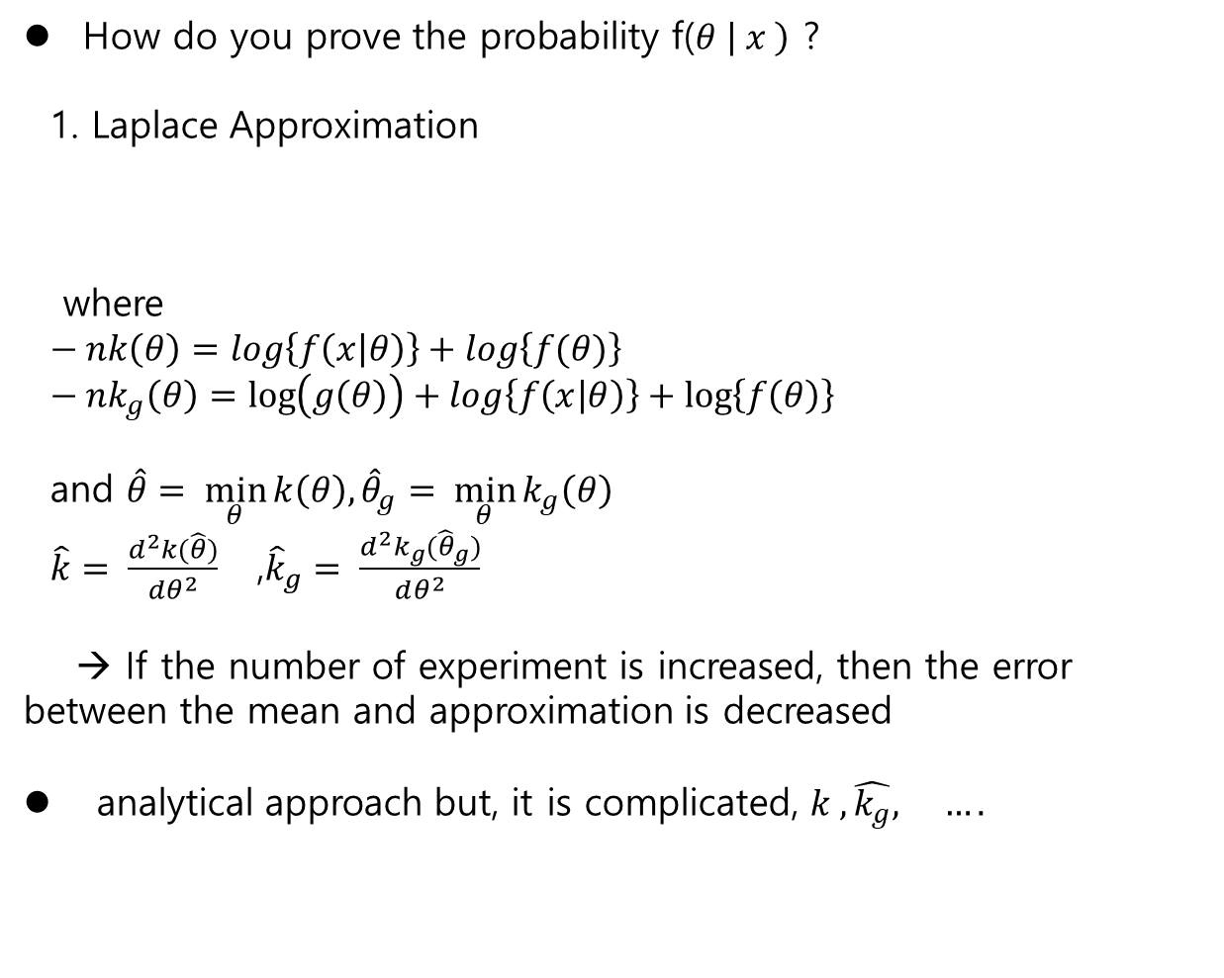
How do you prove the probability f($θ \left| x \right)$ ?
1. Laplace Approximation
where
$− nk\left(θ\right)=log\left\{f\left(x | θ\right)\right\}+log\left\{f(θ)\right\}$
$− nk_{g}\left(θ\right)=\log\left(g\left(θ\right)\right)+log\left\{f\left(x | θ\right)\right\}+\log\left\{f\left(θ\right)\right\}$
and $\hat{θ}= \min_{θ}{k\left(θ\right),{\hat{θ}}_{g}= \min_{θ}{k_{g}\left(θ\right) }}$
$\hat{k}= \frac{d^{2}k(\hat{θ})}{dθ^{2}}$ ,${\hat{k}}_{g}= \frac{d^{2}k_{g}({\hat{θ}}_{g})}{dθ^{2}}$
→ If the number of experiment is increased, then the error between the mean and approximation is decreased
analytical approach but, it is complicated, $k ,\hat{k_{g}}, ….$
$E\left\{g(θ) | x\right\}$ = $\int{g\left(θ\right)f\left(θ \right|x) dθ \sim \sqrt{\frac{\hat{k}}{\hat{\hat{k_{g}}}} exp⁡\left[−n\left\{k_{g}\left({\hat{θ}}_{g}\right) −k(\hat{θ}\right\}\right]} } ∗[1]$
[1]:“Applied Statistical Inference”, 2014

Slide 2

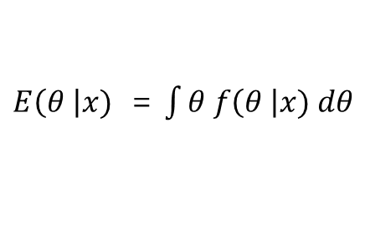
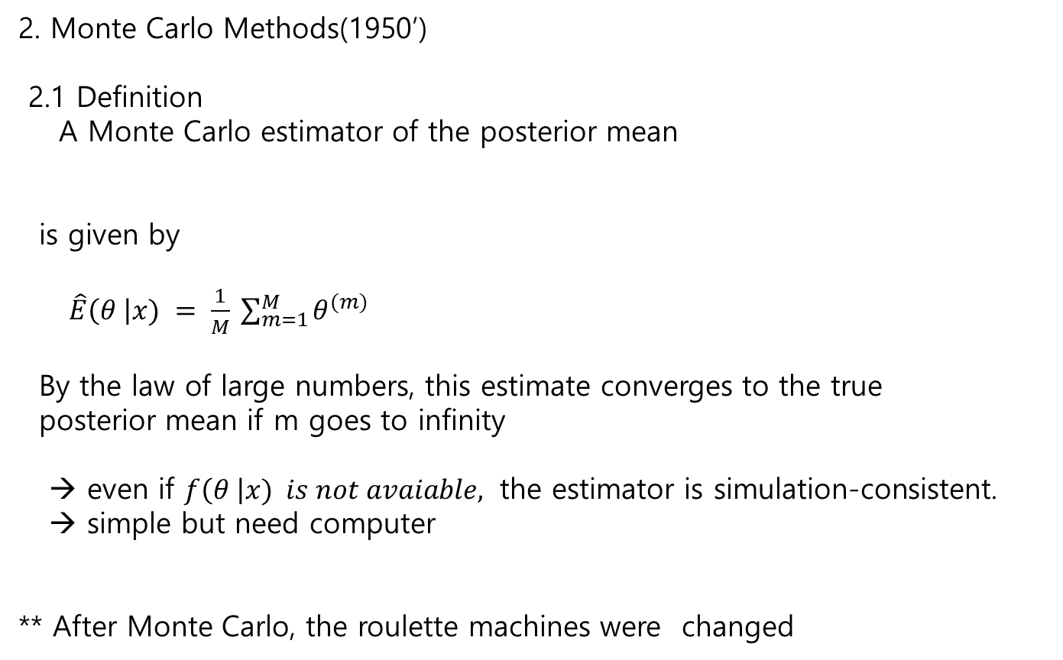
2. Monte Carlo Methods(1950’)
2.1 Definition
A Monte Carlo estimator of the posterior mean
is given by
$\hat{E}\left(θ \right|x) = \frac{1}{M} \sum_{m=1}^{M}{θ^{(m)}}$
By the law of large numbers, this estimate converges to the true
posterior mean if m goes to infinity
→ even if $f\left(θ \right|x) is not avaiable,$ the estimator is simulation-consistent.
→ simple but need computer
** After Monte Carlo, the roulette machines were changed
$E\left(θ \right|x)$ = $\int{θ f\left(θ \right|x) dθ}$

Slide 3
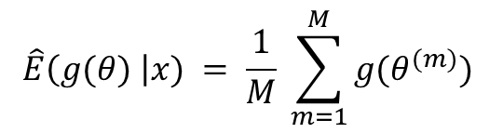
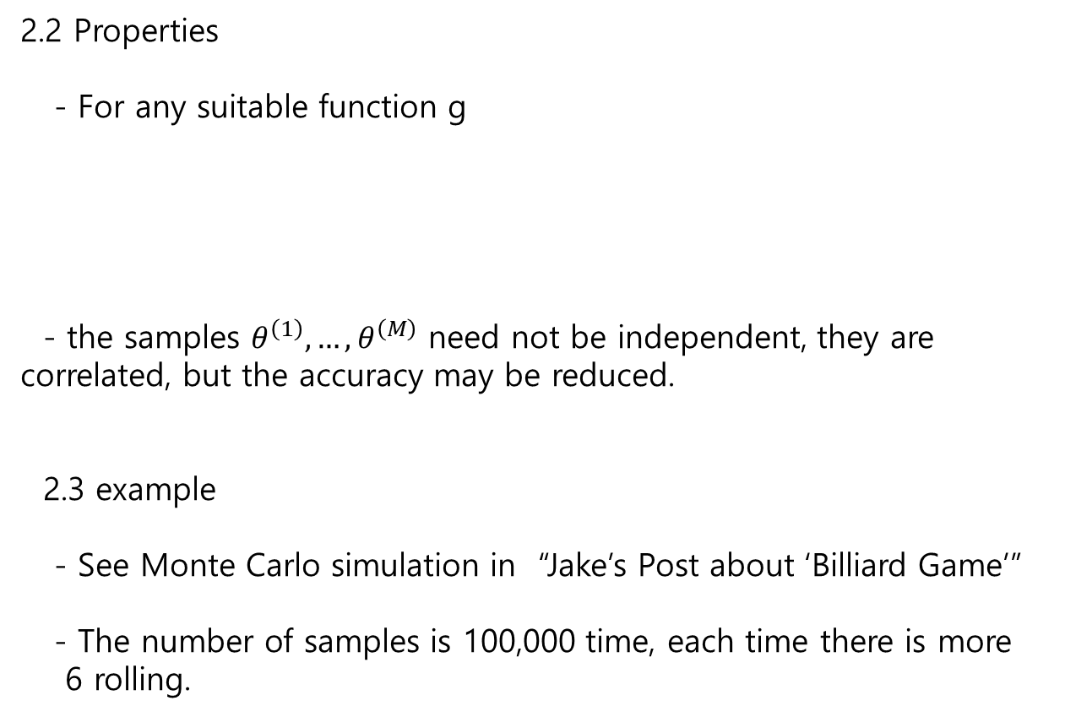
2.2 Properties
- For any suitable function g
- the samples $θ^{\left(1\right)}, …,θ^{\left(M\right)}$ need not be independent, they are correlated, but the accuracy may be reduced.
2.3 example
- See Monte Carlo simulation in “Jake’s Post about ‘Billiard Game’”
- The number of samples is 100,000 time, each time there is more
6 rolling.
$$\hat{E}\left(g(θ) \right|x) = \frac{1}{M} \sum_{m=1}^{M}{{g(θ}^{(m)}) }$$

Slide 4
3. Markov Chain Monte Carlo
- The samples are dependent of many parameters.
ex. The samplings are dependent of two parameters such as Bob win and weather is cloudy
→ for weather is cloudy
for Bob win
end
end
→ total number of simulation is (100,000) ^2 = 10¹⁰ !!
Huge number, if the number of parameters are plural.

Slide 5
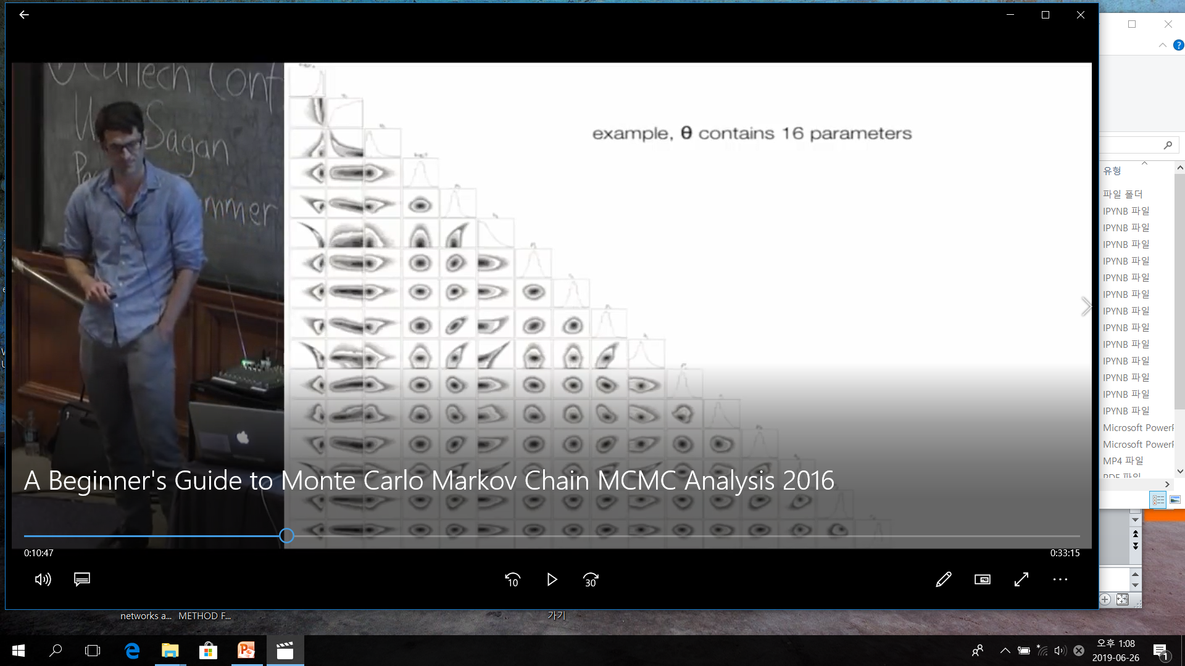
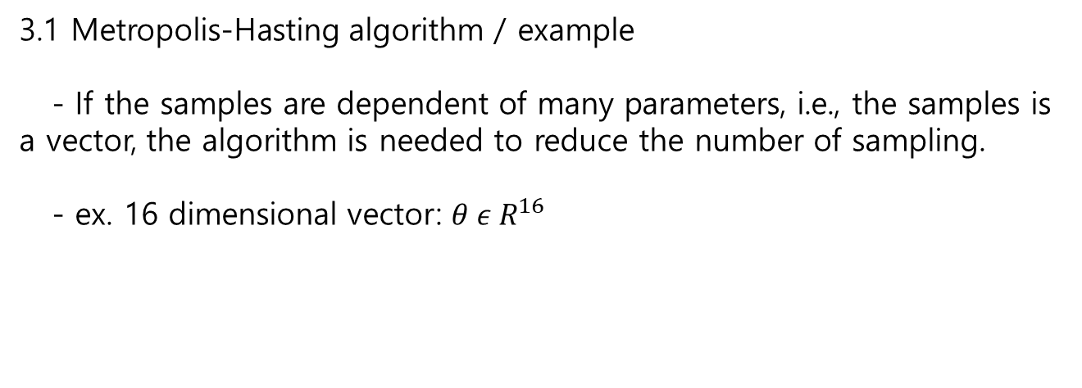
3.1 Metropolis-Hasting algorithm / example
- If the samples are dependent of many parameters, i.e., the samples is a vector, the algorithm is needed to reduce the number of sampling.
- ex. 16 dimensional vector: $θ ε{ R}^{16}$
histogram
Covariance

Slide 6
Look the covariance…

Slide 7
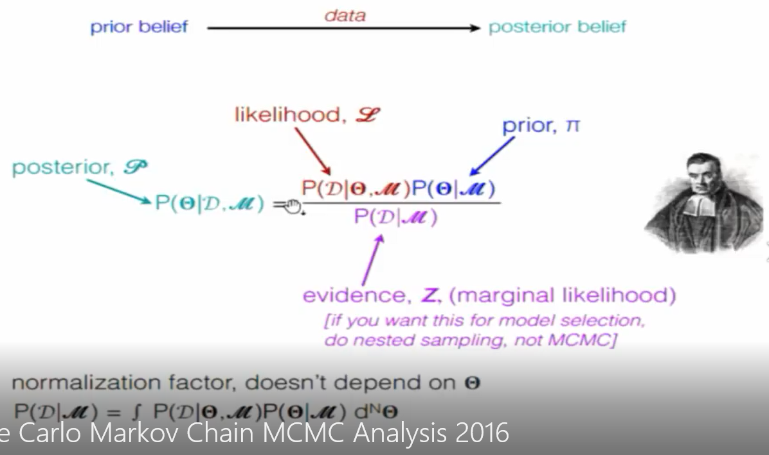
3.2 Metropolis-Hasting algorithm

Slide 8
We need for MCMC
Some measured data
A model
A sampler(not measured data, but simulated data)
An equation for the likelihood

Slide 9
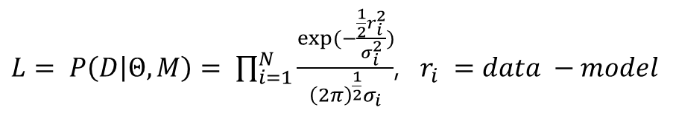
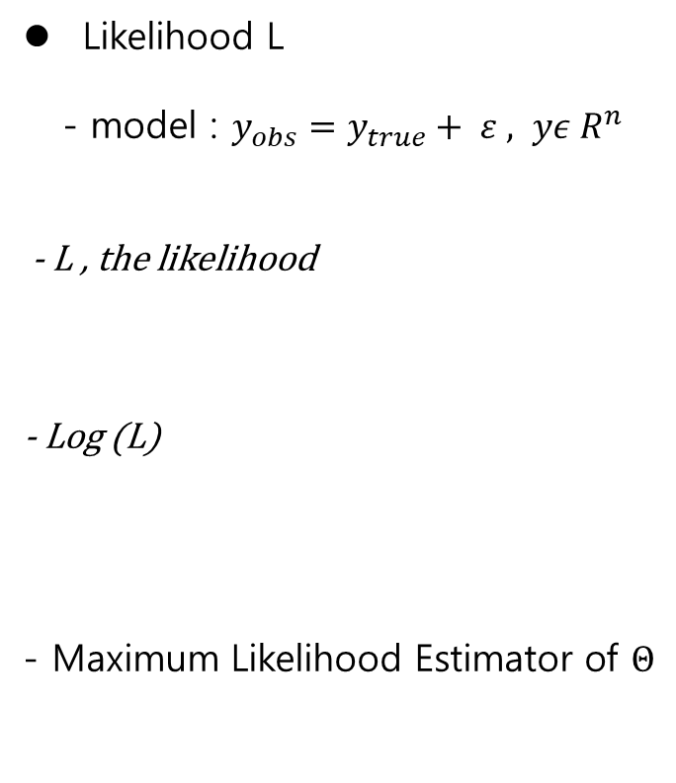
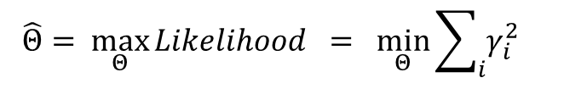
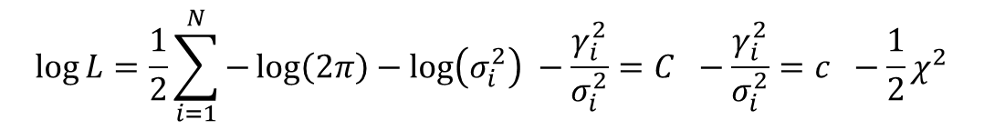
Likelihood L
- model : $y_{obs}=y_{true}+ ε , yε R^{n}$
- L , the likelihood
- Log (L)
- Maximum Likelihood Estimator of $Θ$
$L= P\left(D | Θ,M\right)= \prod_{i=1}^{N}{\frac{exp⁡(−\frac{\frac{1}{2}r_{i}^{2}}{σ_{i}^{2}})}{{\left(2π\right)}^{\frac{1}{2}}σ_{i}}}$, $r_{i} =data −model$
residue
$$\log{L=\frac{1}{2}\sum_{i=1}^{N}{−\log\left(2π\right)−\log\left(σ_{i}^{2}\right) −\frac{γ_{i}^{2}}{σ_{i}^{2}}=C −\frac{γ_{i}^{2}}{σ_{i}^{2}}=c −\frac{1}{2}χ^{2}}}$$
$$\hat{Θ}= \max_{Θ}{Likelihood = \min_{Θ}{{\sum_{i}{γ_{i}^{2}}}_{}}}$$
** Kalman Filter , optimal control for linear system : residue = innovation

Slide 10
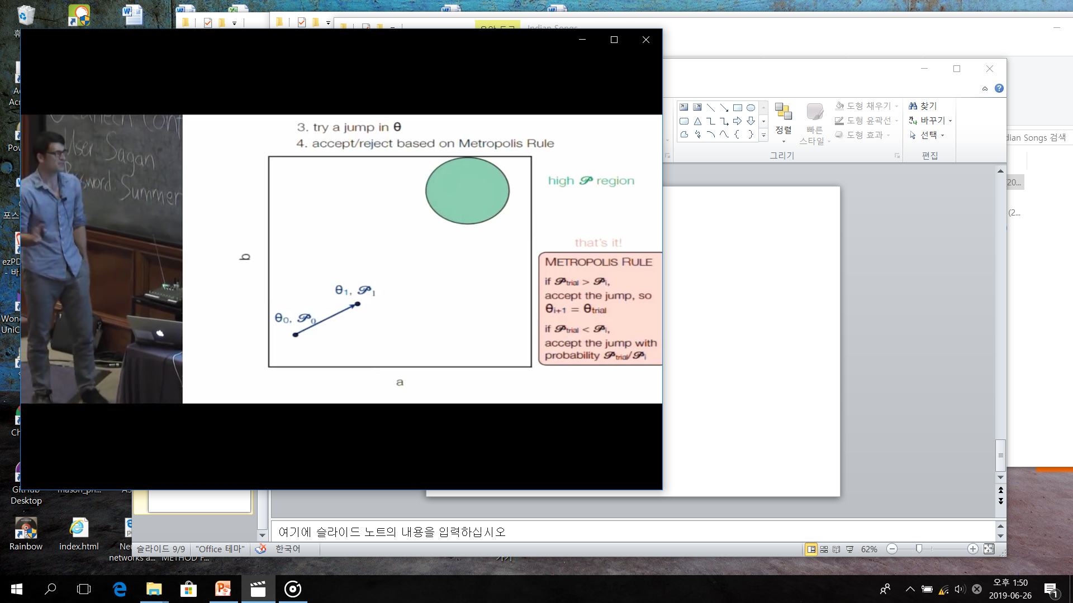
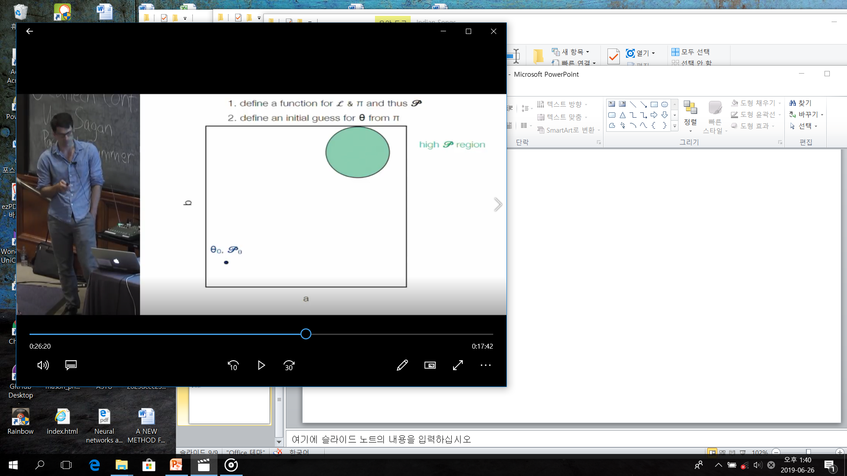
Sampler(Metropolis –algorithm )

Slide 11
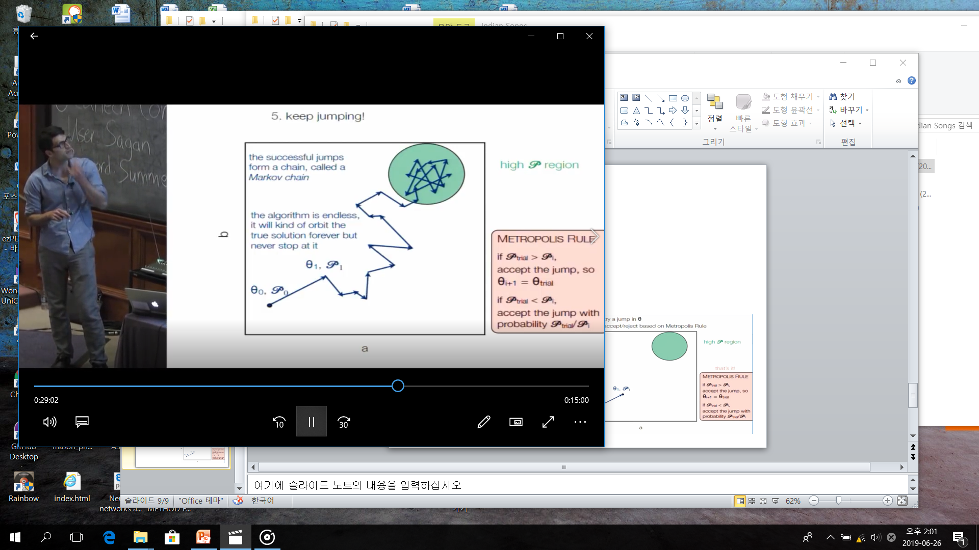
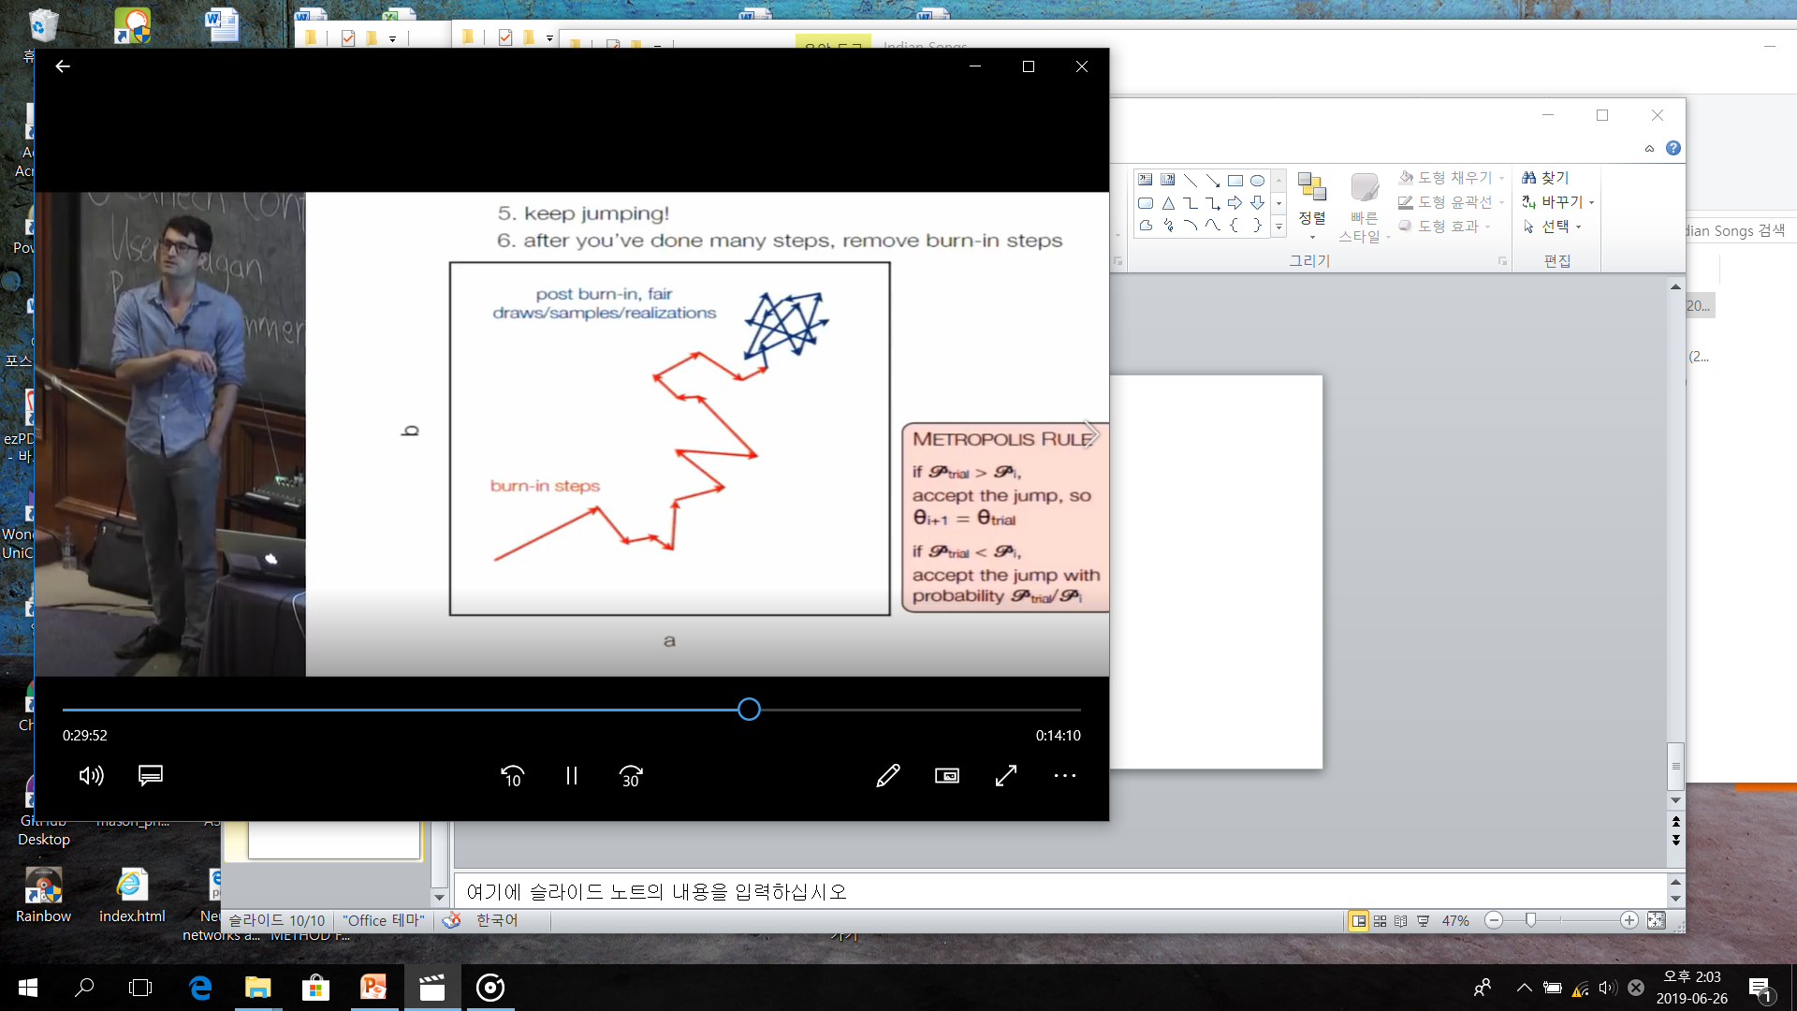
Markov Process

Slide 12
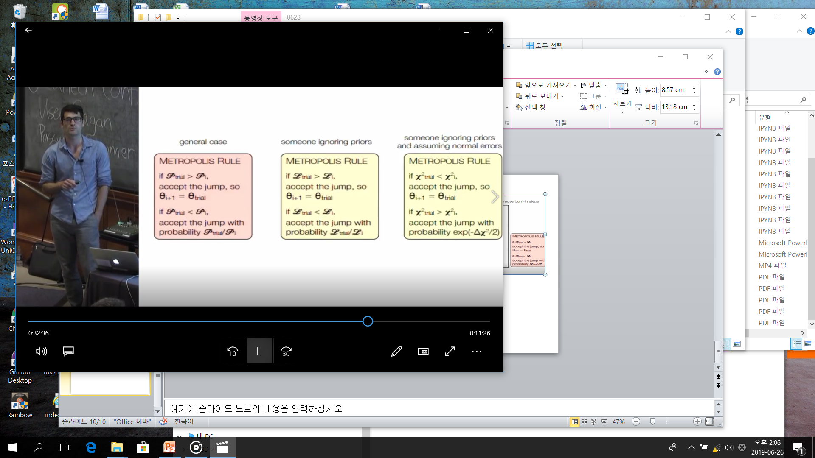
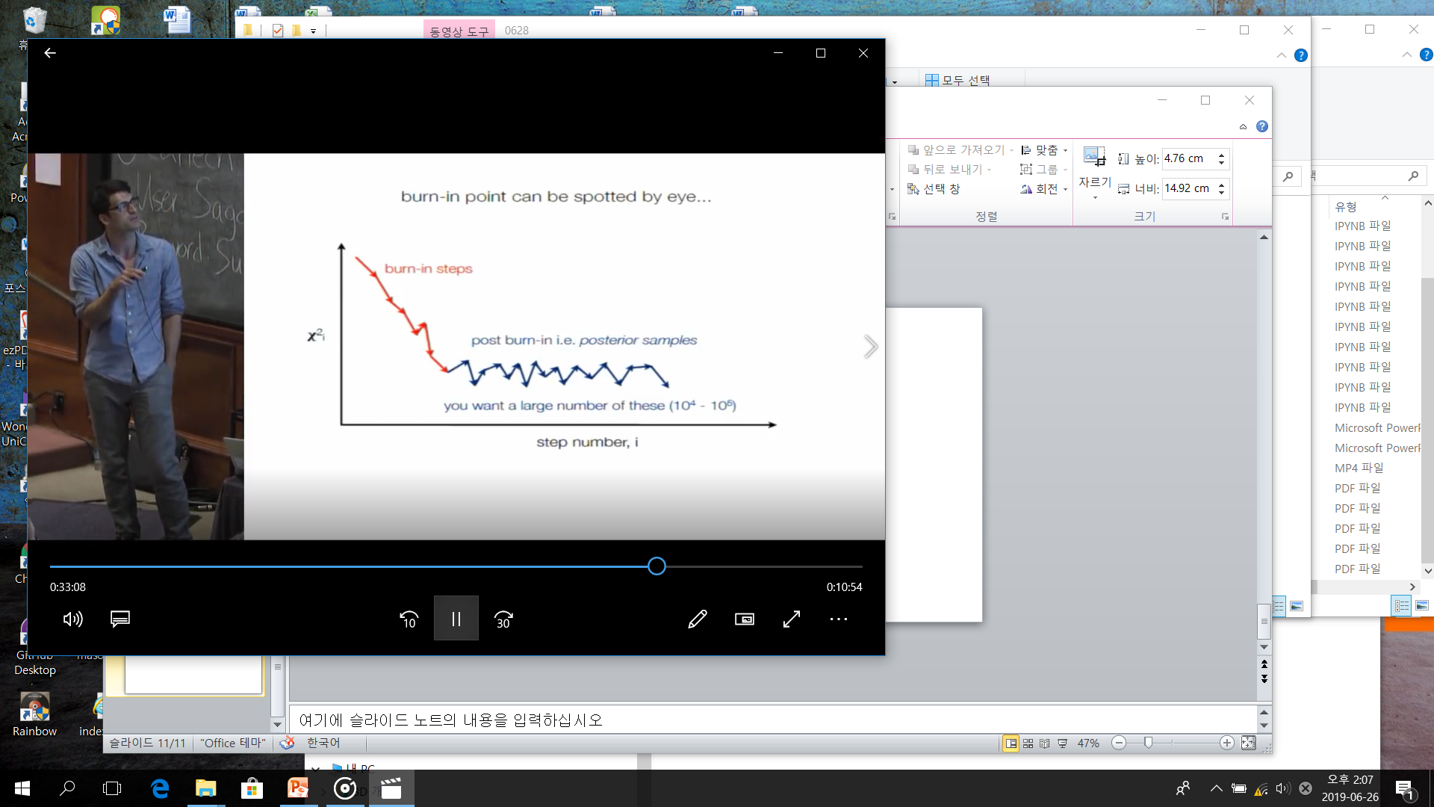

Slide 13


Slide 14
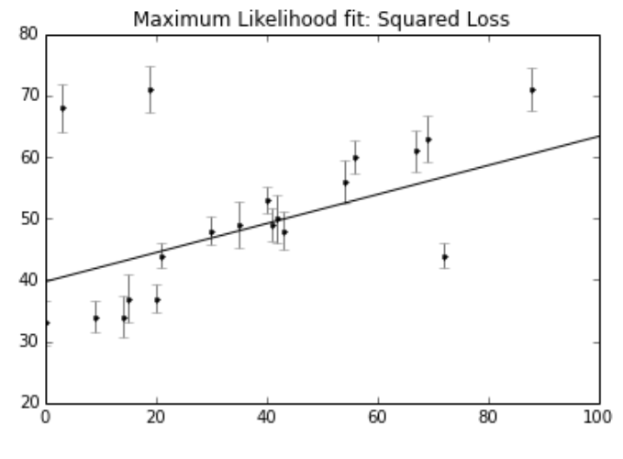
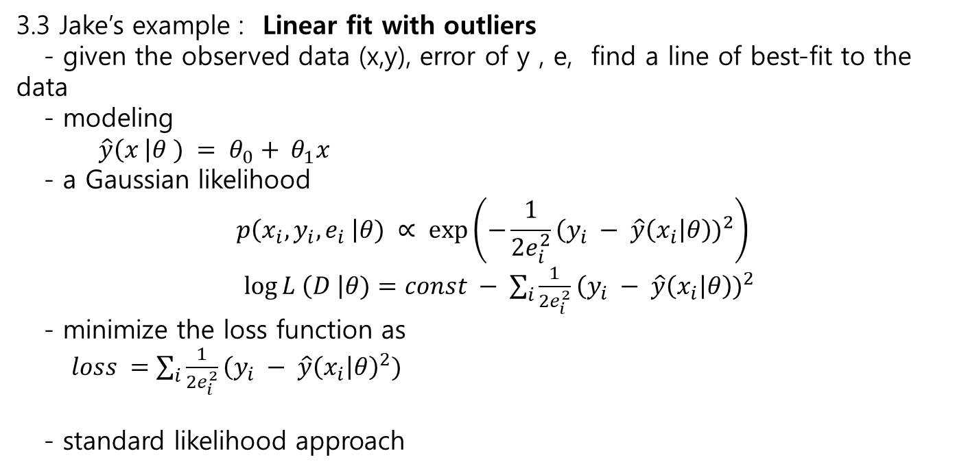
3.3 Jake’s example : Linear fit with outliers
- given the observed data (x,y), error of y , e, find a line of best-fit to the data
- modeling
$\hat{y}\left(x \right|θ ) = θ_{0}+ θ_{1}x$
- a Gaussian likelihood
$$p\left(x_{i}, y_{i},e_{i} \right|θ) ∝ exp⁡\left(−\frac{1}{2e_{i}^{2}}{\left(y_{i} − \hat{y}\left(x_{i}\right|θ\right))}^{2}\right)$$
$\log{L \left(D \right|θ)=const − \sum_{i}{\frac{1}{2e_{i}^{2}}{\left(y_{i} − \hat{y}\left(x_{i}\right|θ\right))}^{2}}}$
- minimize the loss function as
$loss =\sum_{i}{\frac{1}{2e_{i}^{2}}{\left(y_{i} − \hat{y}\left(x_{i}\right|θ\right)}^{2})}$
- standard likelihood approach

Slide 15
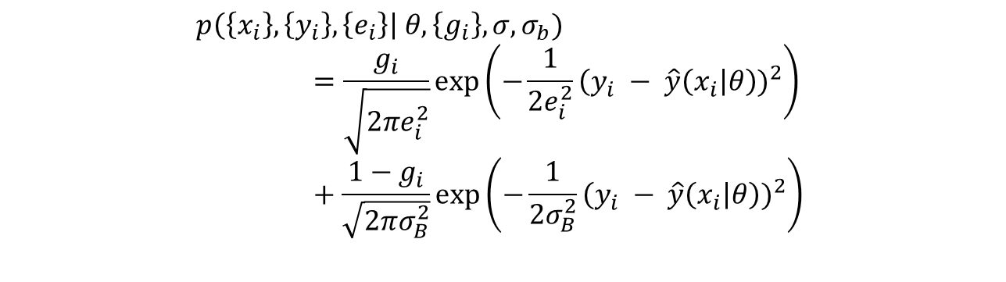
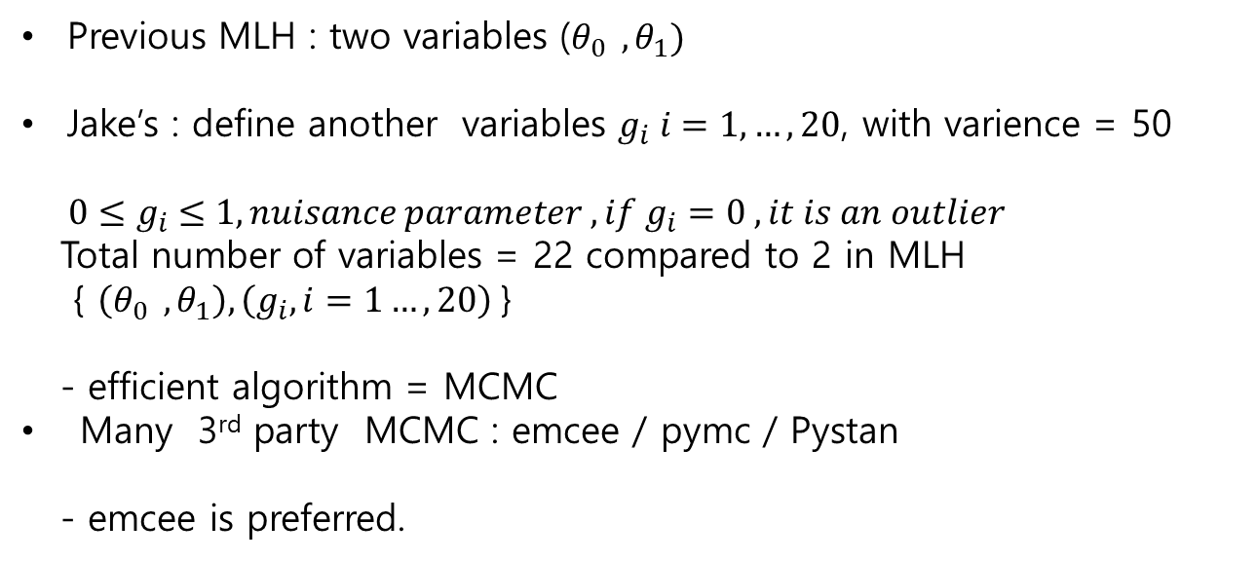
Bayesian approach
Signal
$$p\left(\left\{x_{i}\right\},\left\{y_{i}\right\},\left\{e_{i}\right\}\right| θ, \left\{g_{i}\right\},σ,σ_{b})=\frac{g_{i}}{\sqrt{2πe_{i}^{2}}}exp⁡\left(−\frac{1}{2e_{i}^{2}}{\left(y_{i} − \hat{y}\left(x_{i}\right|θ\right))}^{2}\right) +\frac{1−g_{i}}{\sqrt{2πσ_{B}^{2}}}exp⁡\left(−\frac{1}{2σ_{B}^{2}}{\left(y_{i} − \hat{y}\left(x_{i}\right|θ\right))}^{2}\right)$$
Background
Previous MLH : two variables ($θ_{0 } , θ_{1})$
Jake’s : define another variables $g_{i} i=1,…,20$, with varience = 50
${ 0≤g}_{i} ≤1, nuisance parameter , if g_{i}=0 , it is an outlier$
Total number of variables = 22 compared to 2 in MLH
{ $\left(θ_{0 } , θ_{1}\right), \left(g_{i}, i=1…,20\right)$}
- efficient algorithm = MCMC
Many 3rd party MCMC : emcee / pymc / Pystan
- emcee is preferred.

Slide 16
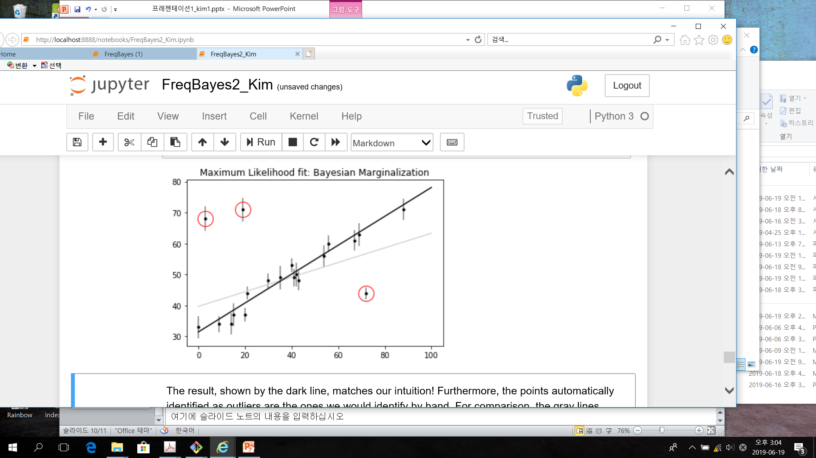
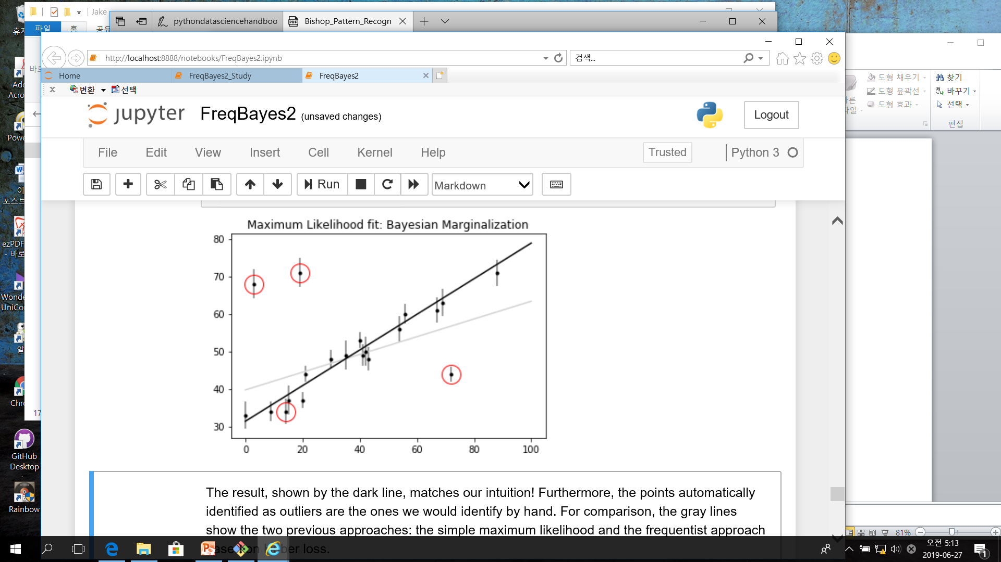
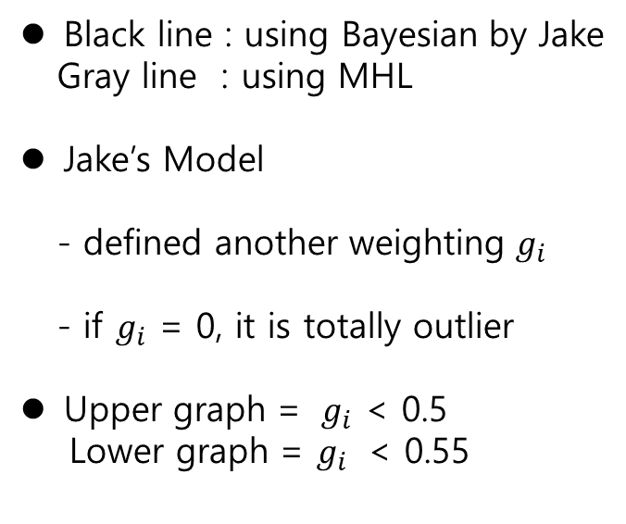
Black line : using Bayesian by Jake
Gray line : using MHL
Jake’s Model
- defined another weighting $g_{i}$
- if $g_{i}$ = 0, it is totally outlier
Upper graph = $g_{i}$ < 0.5
Lower graph = $g_{i}$ < 0.55

Slide 17
Frequentism & Bayesian
- previous post : naïve frequentism is wrong
- linear fitting : marginalizing one way to find the best-fit model,
and marginalizing another way to identify outliers in the data.
- Frequentism :
in Frquentism :
lots of materials ~ p-values, null tests, confidence intervals,
breakdown points, etc.
Do not spend on frequentism.
Should understand Bayes..

